Slide 1
Reinforcement Learning

Slide 2
What is
Reinforcement learning?

Slide 3
Types of learning
Supervised
Reinforcement
Unsupervised

Slide 4
Reinforcement
Learning seeks
to improve
decision making
RL models learn to select actions in effort to maximize potential rewards

Slide 5
What are
the applications of RL?

Slide 6
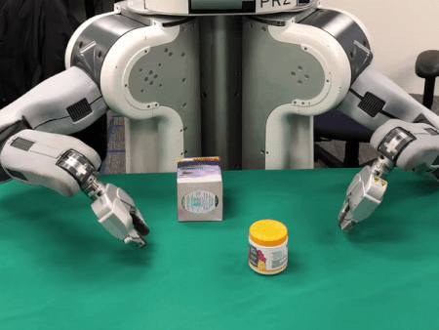
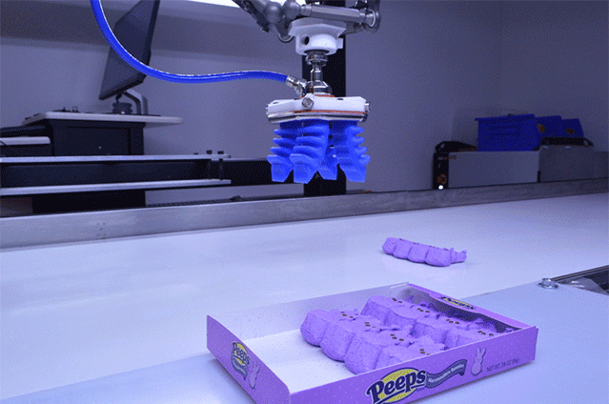
Training robots

Slide 7
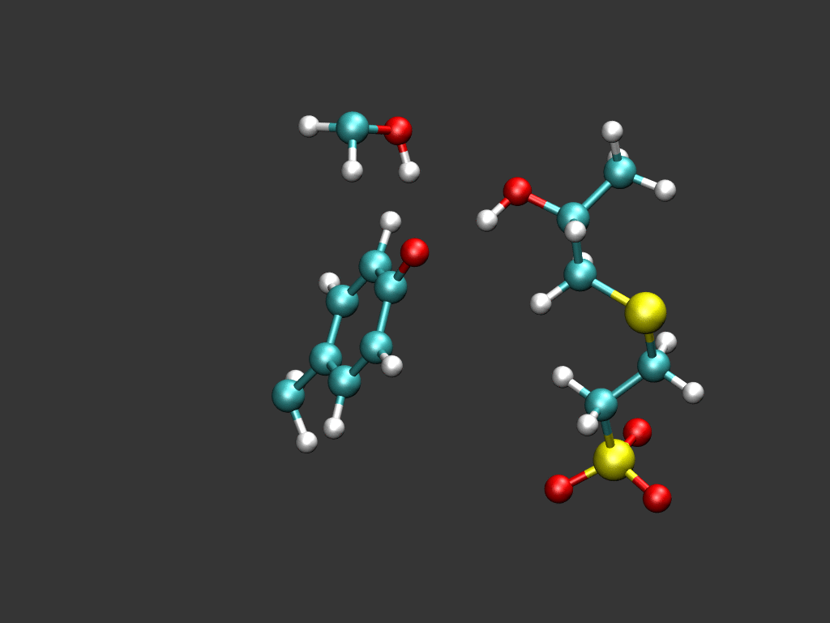
Optimizing chemical reactions

Slide 8
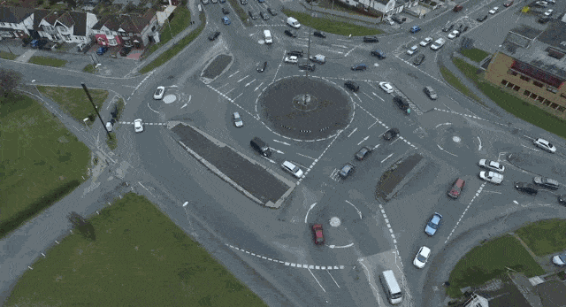
Optimizing traffic flow

Slide 9
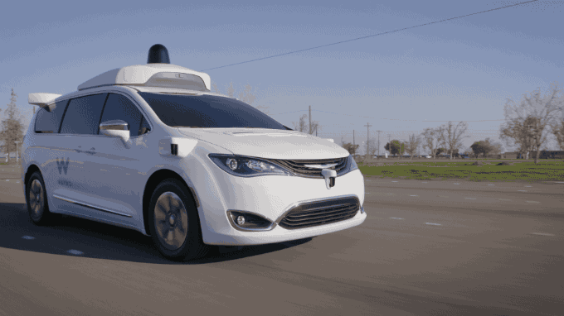
Autonomous vehicles

Slide 10
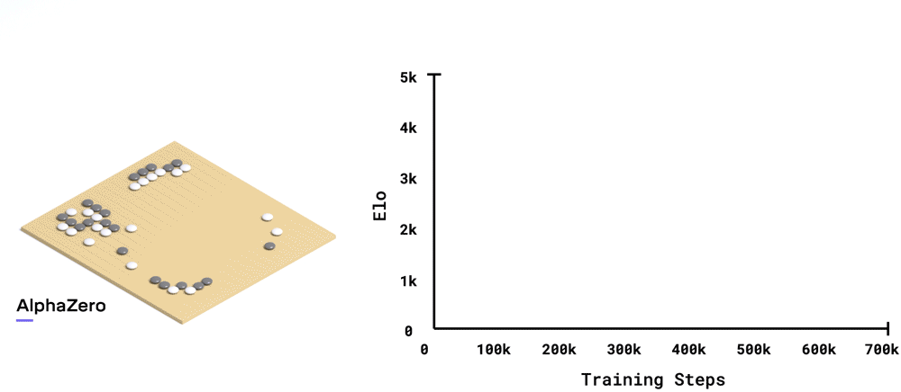
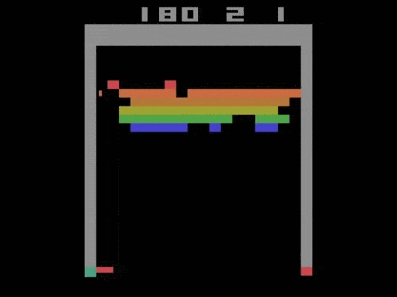
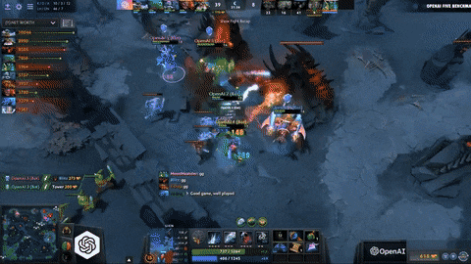
Games

Slide 11
How does
RL work?

Slide 12
Components
Environment
The world in which the other components exist
Agent
The model or player that seeks to improve performance in the environment
States
Different configurations of the environment
Actions
Moves the agent can take at any given state
Rewards
Positive or negative feedback values determined by changes in environment

Slide 13


Slide 14
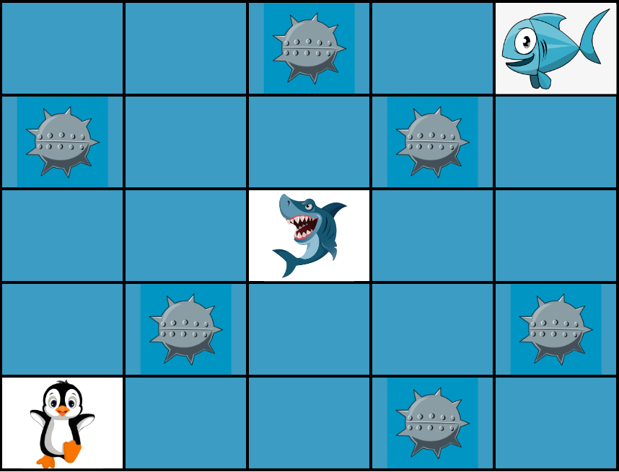
Example

Slide 15
Training the penguin
Penguin moves to | Reward
Empty ocean space | +1
Wall | -1
Shark space | -50
Mine space | -100
Fish space | +100

Slide 16
Q-learning
Q
Learning a policy to select actions that will maximize rewards

Slide 17
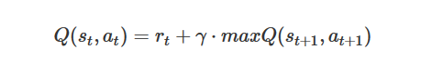
Q-function
Q-value given the current state
and action
The reward for taking the current action
Known as gamma, a discount factor for
future rewards
Maximum possible Q-value for the
following state
Your audience will listen to you or read the content, but won’t do both.

Slide 18
Q-table
 | Action
State | Left | Right | Up | Down
(0,1) | 0 | 0 | 0 | 0
(0,2) | 0 | 0 | 0 | 0
(0,3) | 0 | 0 | 0 | 0
(0,4) | 0 | 0 | 0 | 0
(0,5) | 0 | 0 | 0 | 0
… etc

Slide 19
How can I experiment with reinforcement learning?

Slide 20

Gym
Q
A toolkit for developing and comparing reinforcement learning algorithms

Slide 21
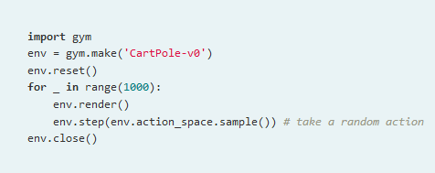
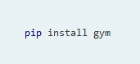
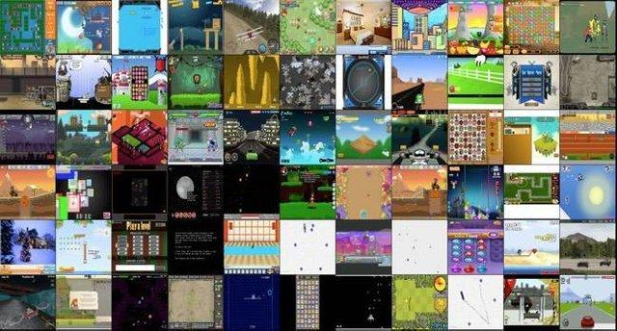
Gym
Use environments to play games, step by step

Slide 22
Activity

Slide 23
Deep Q-network
DQN
Q-learning using a neural network to select optimal actions based on predicted Q-values

Slide 24
Essential components
Experience Replay
Epsilon-greedy Policy
Separate Target Model

Slide 25
Experience Replay
A memory of past actions, state, rewards is stored
After a certain interval, a random sample of the memory is selected
Network is then trained on the entire batch

Slide 26
Separate Target Model
Two models are used - primary model and target model
Target model is used for predictions, primary model is used for training
After an interval, weights from primary model are moved to target model

Slide 27
Epsilon-greedy Policy
A value, epsilon is selected (typically 1) as well as an epsilon rate (typically 0.99 - 0.9999)
Each time the network chooses an action, it has a chance of selecting either a random action or a predicted action
If a random number < epsilon, act randomly

Slide 28
Epsilon-greedy Policy cont.
After a certain interval, epsilon is decayed by the decay rate
Initially, the network will almost always select random actions, gaining new experiences
Over time, more and more actions will be predicted and the network relies on what it has learned.

Slide 29
Choose action via epsilon-greedy
After interval, experience replay
Decay epsilon by decay rate
Store state, action, reward, next state in memory
Transfer weights from primary to target model
Repeat until trained

Slide 30
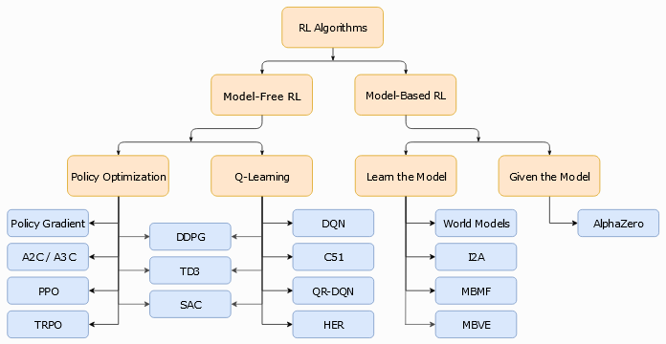
Reinforcement learning taxonomy
http://spinningup.openai.com

Slide 31
Policy Gradients
PG
Developing a policy for actions through the use of predicting action probabilities with a neural network

Slide 32
How policy gradients work
Predict probabilities of actions
Training on each game
No estimation of future Q-values

Slide 33
DQN
Policy Gradient
State
State
Actions
Q-values
Probabilities

Slide 34
DQN
Policy Gradient
More sample efficient
More stable
Usually slower
Regression problem
Better for complex environments
Can handle continuous action spaces
Prone to getting stuck in local minimum
Classification problem

Slide 35
Actor Critic
network
AC
An actor network predicts actions while a critic network predicts the value of taking an action

Slide 36
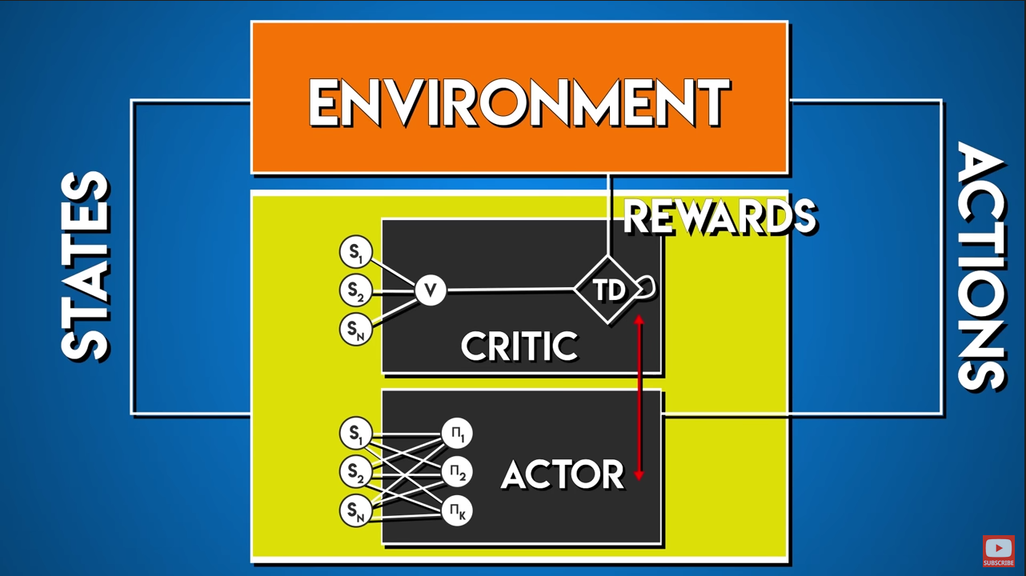

Slide 37

Coast Riders - Human v.s. AI
Human
DQN Agent

Slide 38
Challenges of Reinforcement Learning
Instability
Computationally expensive
Reproducibility
Exploitation

Slide 39


Slide 40
Awesome lectures
Lex Fridman (MIT) -
https://www.youtube.com/watch?v=zR11FLZ-O9M
https://deeplearning.mit.edu/
https://medium.com/tensorflow/mit-deep-learning-basics-introduction-and-overview-with-tensorflow-355bcd26baf0
Emma Brunskill (Stanford) -
https://www.youtube.com/watch?v=FgzM3zpZ55o
David Silver (Google DeepMind) -
https://www.youtube.com/watch?v=2pWv7GOvuf0

Slide 41
Thanks!
Any questions?
You can find this presentation, and the corresponding lesson and lab at:
https://github.com/matthewsparr/Reinforcement-Learning-Lesson

